Slide 1
City of Flagstaff Low Impact Development (LID) Bio-Remediation Soil Design
Final Presentation
Thursday, November 29th, 2018.
Engineering Team:
Meshal Alomar, Abdulrahman Alsubiei, Daniel’le DeVoss, Rebeca Robles
Client and Grading Instructor:
Mark Lamer
Technical Advisor:
Adam Bringhurst

Slide 2
Low Impact Development (LID) Introduction
CONVENTIONAL SYSTEM
Pollution Accumulated
Large Volume
Pollution Remediation
LID
SYSTEM
Pollution Accumulated
Reduced Volume
Groundwater Recharge
Stormwater Runoff

Slide 3
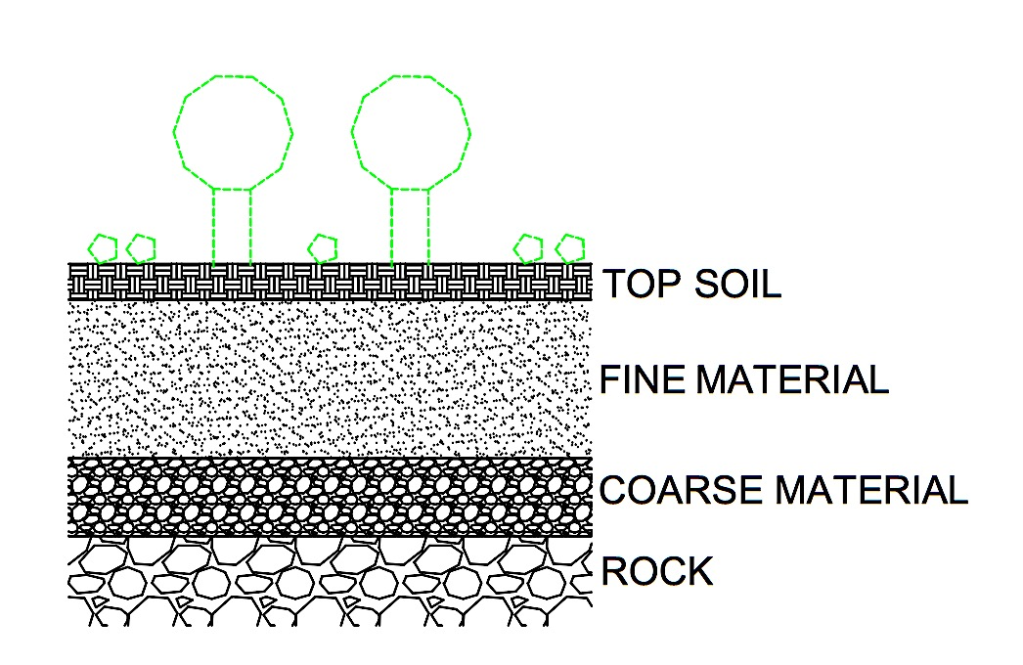
Low Impact Development (LID) Introduction
Capstone Project Goals:
  Design a soil matrix with only locally sourced materials
  Design a soil matrix that infiltrates the first inch of stormwater in one hour
  Assess the bio-remediating efficacy
  Assess impact of adding vegetation
VEGETATION
Figure 1. LID Cross-section

Slide 4
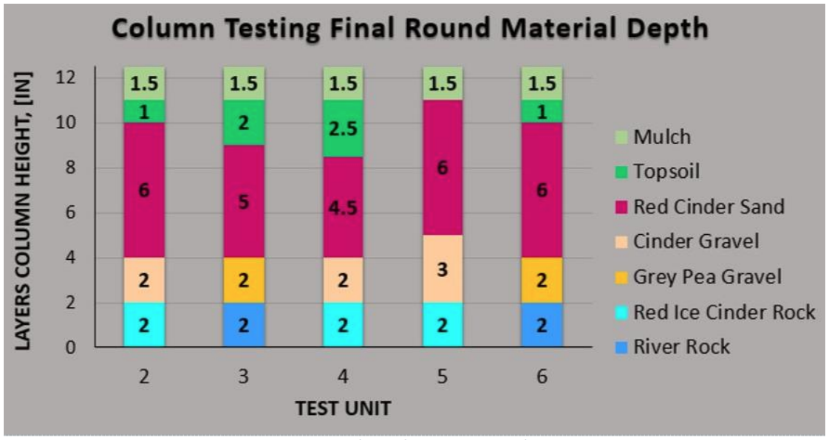
Soil Identification
Figure 2. 2017 LID Capstone Final Round Column Designs [1]
Soil materials chosen based on the 2017 LID Capstone Final Design Report columns 2 and 6.
Mulch layer avoided since team was growing grass on topsoil for further testing.
Soil materials obtained from The Landscape Connection.

Slide 5
Soil Identification
Table 1. Soil Materials Summary [2]
Material Description | Material Origin
½” to ¼” River Rock | Salt River in Phoenix, AZ
Screened Cinders with 25% to 30% dirt Gravel: Material retained on #4 sieve Sand: Material passing #4 sieve but retained on #40 sieve. | The Landscape Connection Pit in Flagstaff, AZ
Concrete Sand | Dyna Pit in Winslow, AZ
Topsoil Mix with 80% native topsoil and 20% composted mule manure | The Landscape Connection Pit in Flagstaff, AZ

Slide 6
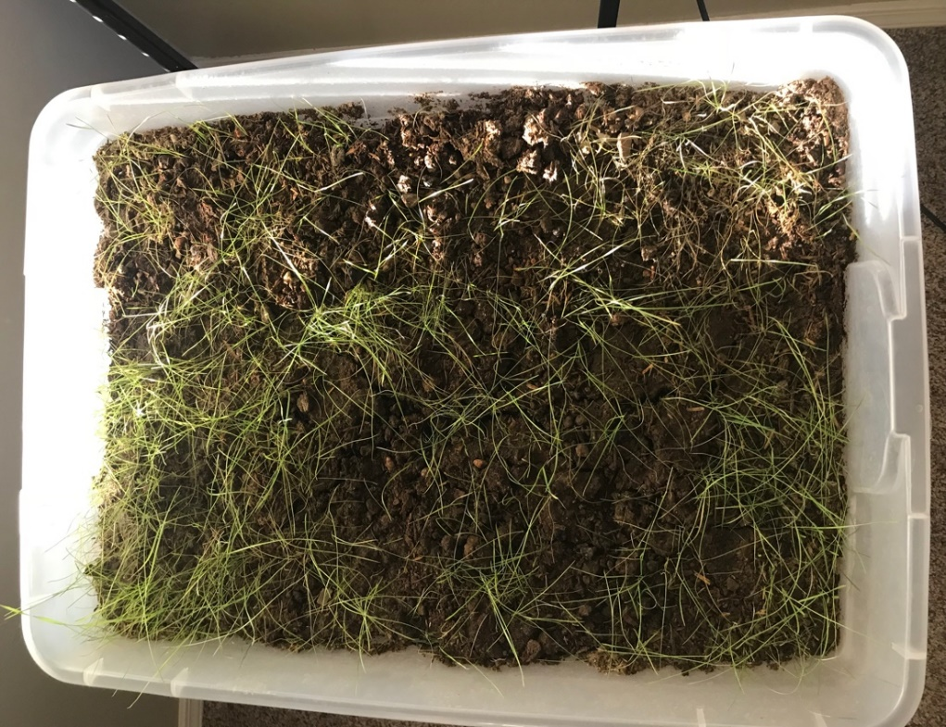
Grass Layer Assessment
Team wanted to assess the impact of a grass layer on infiltration rates and treatment.
Team selected a native grass mix from Warner’s Nursery in Flagstaff, Arizona.
Table 2. Native Grass Mix % and Origins [3]
Origin | Seed Common Name | Mix %
WA | Indian Ricegrass | 19.93
CAN | Sideoats Grama | 19.6
CAN | Fescue Sheep | 11.72
WA | Western Wheat Grass | 11.32
CAN | Blue Grama | 10.75
MN | Bluestern Little | 9.43
NM | Alkali Sacaton | 4.99
TX | James' Galleta | 3.43
CO | Muttongrass | 1.93
- | Inert Matter | 6.85
- | Weed Seed | 0.05
TOTAL |  | 100
Figure 3. Grown Grass Layer by Rebeca Robles
Notes:
BECA

Slide 7
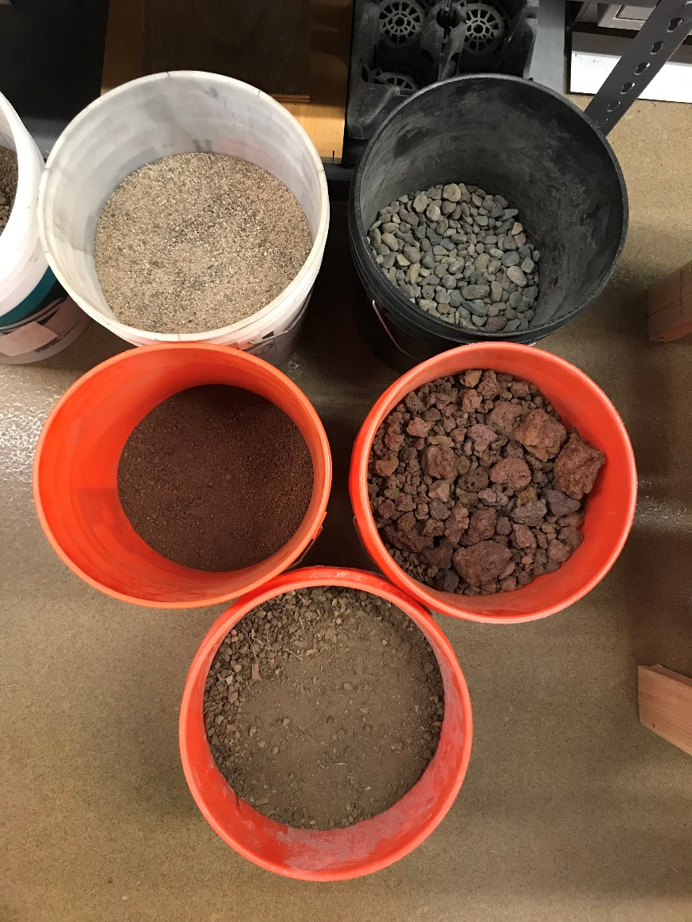
Soil Testing
Concrete Sand
River Rock
Team tested the following on soil materials:
Hydraulic Conductivity
Specific Gravity
Saturated Surface Dry (SSD) Test
Cinder Sand
Cinder Gravel
Topsoil
Figure 4. Soil Materials by Rebeca Robles
Notes:
Test at NAU and WTI

Slide 8

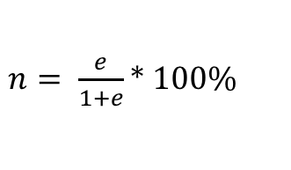



Hydraulic Conductivity, Void Ratio, and Porosity
Followed ASTM D5856-15
Conducted on all four-soil material (3 tests per type of soil)
Void Ratio
Porosity
$$e= \frac{G_{s}∗ρ_{w}}{ρ_{d}} −1$$
$n= \frac{e}{1+e}$ * 100%
Density of Soil Sample
Hydraulic Gradient
$$i= \frac{h}{L}$$
$$ρ_{d}=\frac{M_{2} − M_{1}}{A ∗L}$$
L= Length
V= Volume
A= Area
M1= mass of the permeameter device without soil
M2= mass of the permeameter device with soil
Gs= Specific Gravity
H= Height
Pd= Density of The Compacted Soil
Q= Flow rate
Hydraulic Conductivity
$$k= \frac{Q}{A ∗i}$$
Figure 5. Hydraulic Conductivity Example [4]
Notes:
Explain what M1 and M2 is, the specific gravity from tests performed, explain the difference between h and L using picture.

Slide 9
Hydraulic Conductivity, Void Ratio, and Porosity Results
Table 3. Hydraulic Conductivity Summary Table
Soil Material | Test # | k (ft/s) | e | n (%)
Screened Cinders | 1 | 0.00149 | 0.25 | 20.009
 | 2 | 0.0012 | 0.148 | 12.873
 | 3 | 0.00127 | 0.218 | 17.902
AVERAGE |  | 0.00132 +/- 0.00015 | 0.205 +/- 0.052 | 16.928 +/- 3.67
1/2" to 1/4" River Rocks | 1 | 0.00151 | 0.255 | 20.314
 | 2 | 0.00136 | 0.231 | 18.772
 | 3 | 0.00136 | 0.255 | 20.314
AVERAGE |  | 0.00141 +/- 0.000087 | 0.247 +/- 0.014 | 19.8 +/- 0.89
Concrete Sand | 1 | 0.00102 | 0.183 | 15.448
 | 2 | 0.00108 | 0.204 | 16.919
 | 3 | 0.00105 | 0.182 | 15.383
AVERAGE |  | 0.00105 +/- 0.000030 | 0.189 +/- 0.012 | 15.916 +/- 0.87
Topsoil Mix | 1 | 0.00014 | 0.284 | 22.107
 | 2 | 0.00014 | 0.255 | 20.306
 | 3 | 0.00014 | 0.318 | 24.127
AVERAGE |  | 0.00014 +/- 0.00 | 0.286 +/- 0.032 | 22.18 +/- 1.91

Slide 10

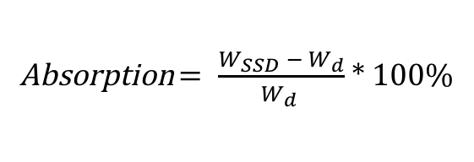

Specific Gravity and SSD Test
Specific Gravity
Saturated Surface Dry Specific Gravity
$$G_{s}= \frac{W_{d}}{W_{SSD} − W_{sat}}$$
SSD $= \frac{W_{SSD}}{W_{SSD} − W_{sat}}$
Absorption
Wd= Mass of dry soil
Wsat= Mass of saturated soil
WSSD = Mass of Saturated surface dry
Absorption $= \frac{W_{SSD} − W_{d}}{W_{d} }$ * 100%
Followed ASTM C127-15 for coarse aggregates and ASTM C128-15 for fine aggregates.
Conducted only on screened cinders, river rocks, and concrete sand at the Western Technologies Inc. lab and were recommended to not do testing on topsoil.

Slide 11
Specific Gravity and SSD Test
Table 4. Specific Gravity and SSD Summary Table
Material | Test # | Specific Gravity | Specific Gravity (SSD) | Absorption (%)
Screened Cinders | 1 | 2.031 | 2.300 | 8.808
 | 2 | 2.030 | 2.140 | 8.970
 | 3 | 2.032 | 2.190 | 8.990
AVERAGE |  | 2.031 +/- 0.001 | 2.21 +/- 0.082 | 8.923 +/- 0.099
1/2" to 1/4" River Rocks | 1 | 2.567 | 2.799 | 1.469
 | 2 | 2.667 | 2.676 | 1.325
 | 3 | 2.778 | 2.697 | 1.256
AVERAGE |  | 2.671 +/- 0.11 | 2.724 +/- 0.066 | 1.35 +/- 0.11
Concrete Sand | 1 | 2.487 | 2.643 | 2.045
 | 2 | 2.607 | 2.544 | 2.108
 | 3 | 2.578 | 2.654 | 2.044
AVERAGE |  | 2.557 +/- 0.063 | 2.614 +/- 0.061 | 2.066 +/- 0.037

Slide 12
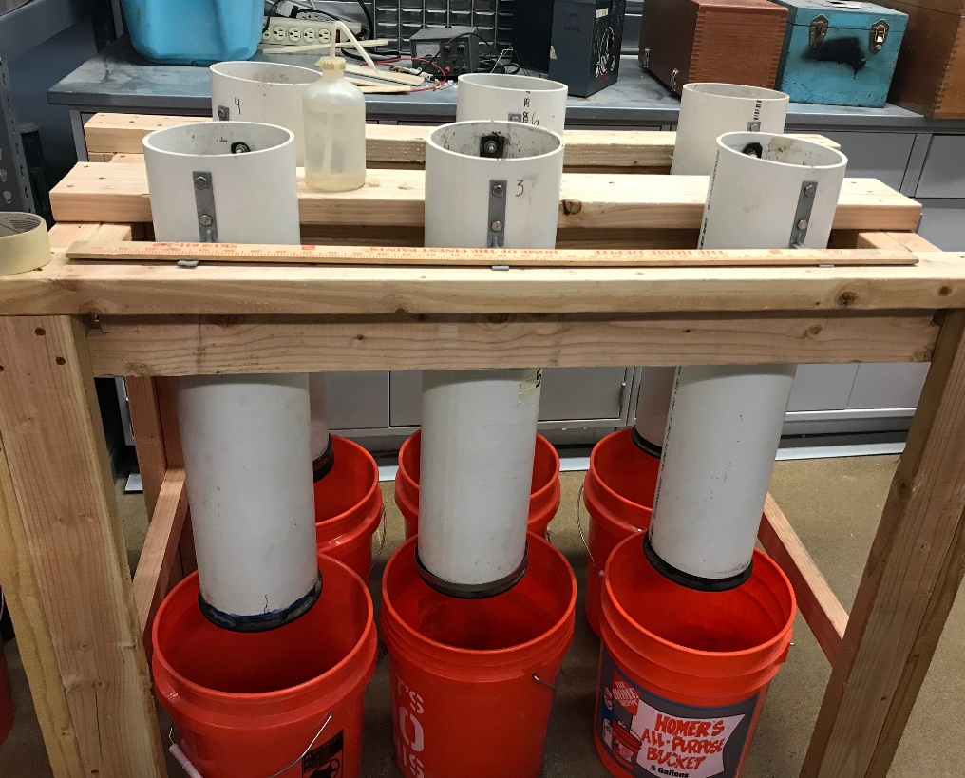
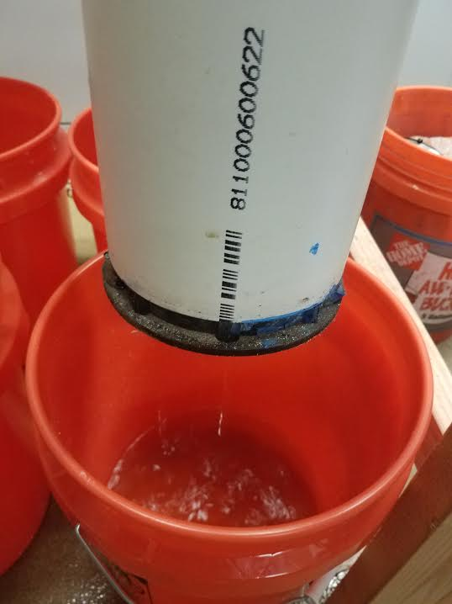
Soil Matrix Design
2017 LID Capstone Soil Matrix Testing Method [1]:
    Similar to Percolation Test.
  Dry Test
  Saturated Test right after dry test to mimic worst case scenario of multiple storms within a short period of time.
  Void Space Volume Test
Figure 6. Testing Unit by Rebeca Robles
Figure 7. Infiltrated Water Collection by Daniel’le De Voss
Notes:
6 inch diameter holes, 12 inch deep, performing dry test, and saturated test. Not letting water pond at 12 inches for 24 hourr.

Slide 13
Soil Media Testing Round #1
Figure 8. Soil Media Testing Round #1 Graph
Designs based on column designs 2017 LID Capstone Final Design Report.
Designs conducted with different sands.

Slide 14
Soil Media Testing Round #2
Figure 9. Soil Media Testing Round #2 Graph
Experimented with different topsoil mix layer heights and with a topsoil mix with grass layer.

Slide 15
Soil Media Testing Round #1 and #2 Results
Table 5. Soil Media Testing Round #1 Results
Round #1
 | Infiltration Rate (in/hr)
Type of Test | Unit 1 (screened cinders sand) | Unit 2 (concrete sand)
Dry Test | 8.95 | 8.55
Saturated Test | 7.96 | 12.54
Table 6. Soil Media Testing Round #2 Results
Round #2
 | Infiltration Rate (in/hr)
Type of Test | Unit 3 (2in topsoil) | Unit 4 (1 in topsoil) | Unit 5 (topsoil mix with grass)
Dry Test | 2.98 | 8.30 | 8.82
Saturated | 11.42 | 5.32 | 6.46

Slide 16
Soil Media Testing Round #3
Retested Design #4, and tested Design #4 with a grass layer
Table 7. Soil Media Testing Round #3 Results
Round #3
Test Type | Design #4 Retest #1 | Design #4 Retest #2 | Design #4 Retest #3
Dry Test (in/hr) | 9.49 | 9.44 | 10.01
Saturated Test #1 (in/hr) | 8.98 | 8.99 | 8.12
Saturated Test #2 (in/hr) | 6.45 | 7.04 | 6.87
Void Space Volume (mL) | 1646 | 1543 | 1536
Void Space Volume (mL/ft^3) | 6330.77 | 5934.62 | 5907.69
Table 8. Soil Media Testing Round #3 Results (2)
Round #3
Test Type | Design #4 with Grass #1 | Design #4 with Grass #2 | Design #4 with Grass #3
Dry Test (in/hr) | 11.24 | 11.49 | 11.04
Saturated Test #1 (in/hr) | 10.92 | 9.13 | 10.3
Saturated Test #2 (in/hr) | 9.86 | 8.66 | 8.78
Void Space Volume (mL) | 1858 | 1755 | 1844
Void Space Volume (mL/ft^3) | 7146.15 | 6750.00 | 7092.31
Notes:
BECA

Slide 17
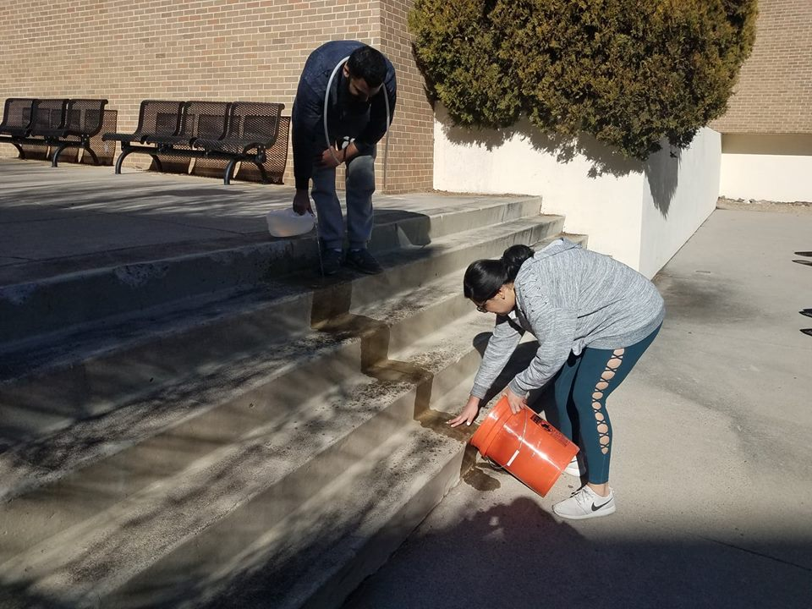
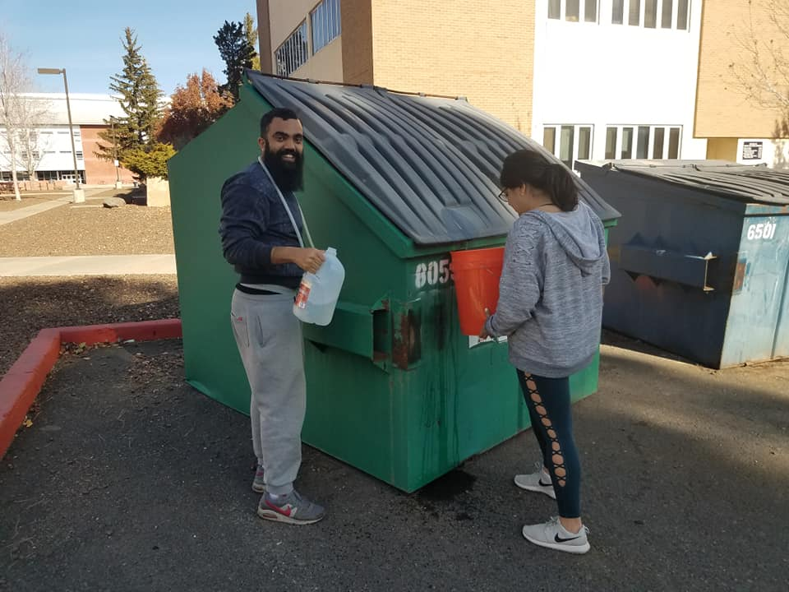
Stormwater Sampling
Figure 10. Contaminating Water by Pouring Over Outdoor Stairs by Daniel’le DeVoss
Figure 11. Contaminating by Pouring Over a Dumpster Lid by Daniel’le DeVoss
Notes:
Daniel’le

Slide 18
Stormwater Testing
Tested the stormwater turbidity, total phosphorus, and total coliform before and after infiltrating it through the soil media columns to assess the columns ability to remediate.
Design #4
Design #4
Design #4 with Grass
Design #4 with Grass
1
1
1
1
2
2
2
2
3
3
3
3
Notes:
ADD ASTM Methods

Slide 19
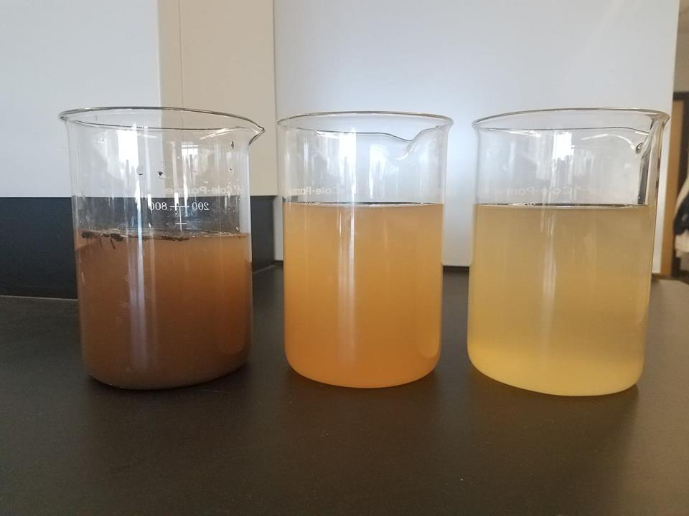
Turbidity and Total Phosphorous Testing
Followed ASTM D6855-12 for Turbidity
Followed HACH Method #10127 for Total Phosphorous
Water Treated without Grass
Water Treated with Grass
Untreated Water
Figure 12. Untreated and Treated Water Samples by Daniel’le DeVoss

Slide 20
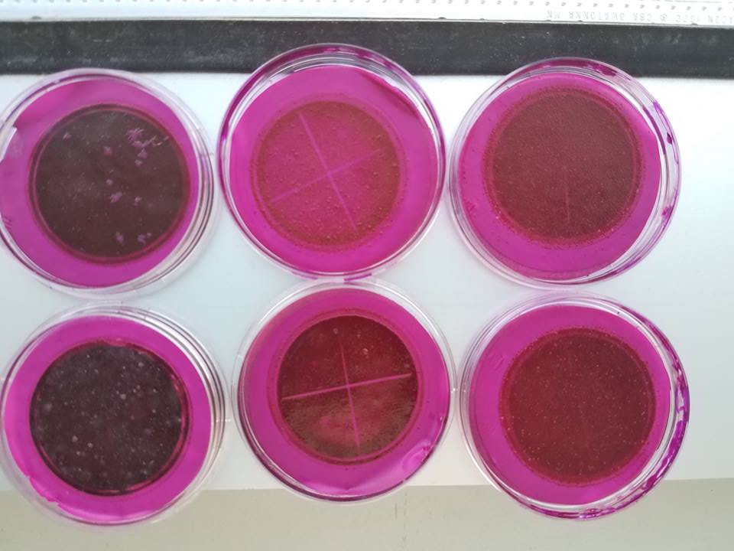
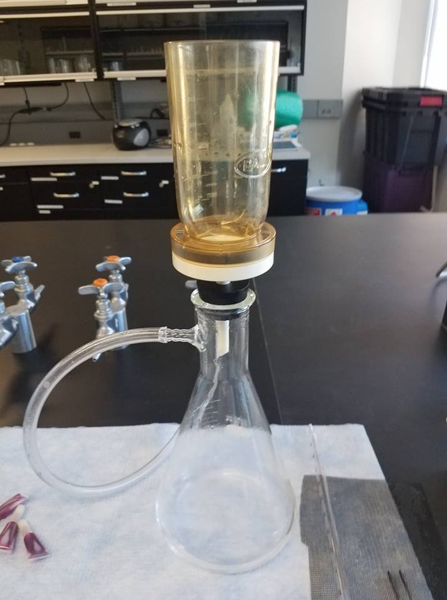
Coliform Testing
Followed HACH Method #8074
Water Treated with Grass
Untreated Water
Water Treated without Grass
Figure 13. Vacuum Filtration Apparatus By Daniel’le DeVoss
Figure 14. Petri Dishes After Incubation by Daniel’le DeVoss

Slide 21

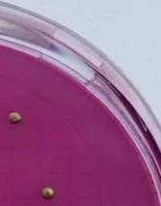
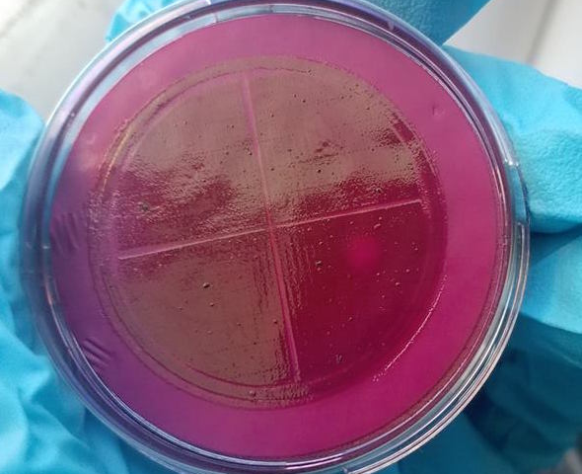
Coliform Testing
Figure 15. Diluted Samples and Close-up of Isolated Colonies by Daniel’le DeVoss

Slide 22
Summary of Water Quality Results
Table 9. Stormwater Quality Results Summary
 | Turbidity |  | Total Phosphorus |  | Total Coliform
 | NTU |  | mg P/L |  | CFUs/ 100 mL
Untreated Water
Average | 864 +/- 45.08 |  | 34.7 +/- 2.71 |  | 404.17 +/- 79.78
After Treatment
 | Grass | No Grass | Grass | No Grass | Grass | No Grass
Average | 86.5 +/- 1.03 | 267.25 +/- 17.97 | 1.47 +/- 0.67 | 3.32 +/- 0.32 | 147.50 +/- 60.53 | 220.83 +/- 40.21
Percent Removal | 90% | 69% | 96% | 90% | 64% | 45%

Slide 23
Selecting Final Matrix Design
Design #4 with a Grass Layer was selected as the final soil matrix design:
  Infiltration Rate = 9.1 in/hr
  Storage Capacity = 7.3 L/ft²
  Ability to treat different stormwater contaminants.
  For a proposed Area of 500 ft²:
    Total Water Storage Capacity = 128.47 ft³ or 3,637.86 L
Figure 16. Final Soil Matrix Design

Slide 24
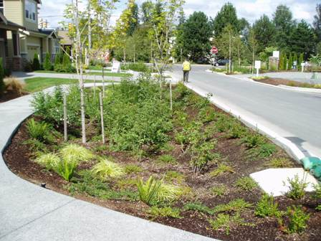
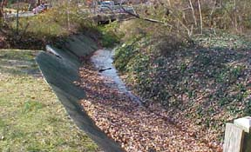
Project Impacts
Economic Impact
  Prevent infrastructure damages caused by floods.
  Reduce the cost of water treatment
Environmental Impact
  Reduction of sediments, nutrients, and coliform from the stormwater runoff.
Social Impact
  Enhancing community aesthetics using natural elements.
Figure 17. City of Kirkland, WA LID [5]
Figure 18. Concrete stow water
management system [6]
Notes:
Meshal

Slide 25
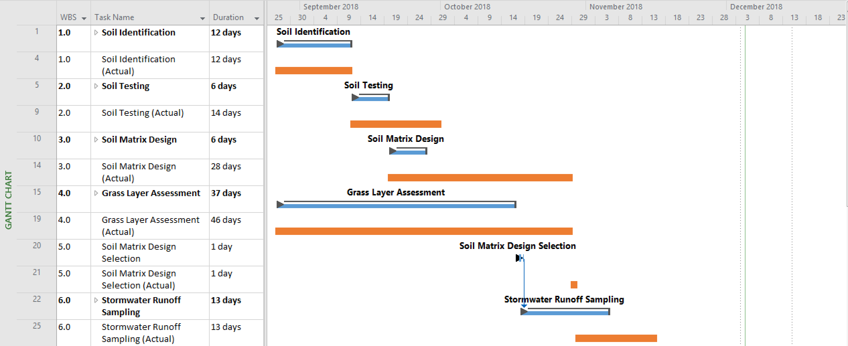
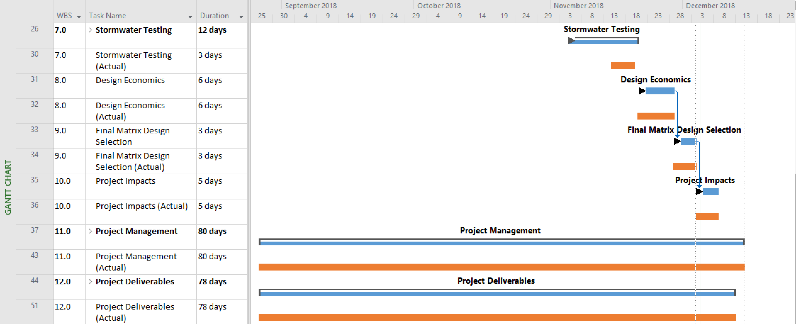
Project
Schedule
Figure 19. Schedule Gantt Chart

Slide 26
Engineering Work
Table 10. Estimated Staffing Hours Table
Estimated Staffing Hours
Task | Senior Engineer (hr) | Lab Manager/P.E (hr) | Lab Tech (hr) | Field Tech (hr)
1. Soil Identification | 2 | 2 | 0 | 0
2. Soil Testing | 3 | 3 | 20 | 0
3. Soil Matrix Design | 5 | 10 | 10 | 0
4. Vegetative Coverage Testing | 3 | 10 | 30 | 0
5. Soil Matrix Design Selection | 2 | 5 | 48 | 0
6. Stormwater Run-off Sampling | 2 | 10 | 0 | 40
7. Stormwater Testing | 5 | 7 | 5 | 0
8. Design Economics | 3 | 10 | 0 | 0
9. Selection of Final Soil Matrix Design | 5 | 10 | 5 | 0
10. Project Impacts | 3 | 6 | 0 | 0
11. Project Management | 98 | 98 | 98 | 98
12. Project Deliverables | 36 | 36 | 36 | 36
SUBTOTAL HOURS | 167 | 207 | 252 | 174
 |  |  | TOTAL HOURS | 800
Notes:
Rebeca

Slide 27
Engineering Work
Table 11. Actual Staffing Hours Table
Actual Staffing Hours
Task | Senior Engineer (hr) | Lab Manager/P.E (hr) | Lab Tech (hr) | Field Tech (hr)
1. Soil Identification | 3 | 3 | 0 | 0
2. Soil Testing | 9 | 9 | 9 | 0
3. Soil Matrix Design | 28.5 | 33.5 | 28.5 | 0
4. Vegetative Coverage Testing | 14 | 14 | 45 | 0
5. Soil Matrix Design Selection | 5 | 5 | 25 | 0
6. Stormwater Runoff Sampling | 0 | 0 | 0 | 4
7. Stormwater Testing | 13.5 | 13.5 | 13.5 | 13.5
8. Design Economics | 5 | 5 | 0 | 0
9. Selection of Final Soil Matrix Design | 10 | 10 | 0 | 0
10. Project Impacts | 3 | 3 |  | 0
11. Project Management | 12.5 | 12.5 | 12.5 | 12.5
12. Project Deliverables | 31 | 31 | 31 | 31
SUBTOTAL HOURS | 134.5 | 139.5 | 164.5 | 61
 |  |  | TOTAL HOURS | 499.5

Slide 28
Engineering Costs
Table 12. Total Staffing Costs Summary Table [7]
Item | Senior Engineer | Lab Manager/P.E. | Lab Tech | Field Tech
Pay ($/hr) | $92 | $38 | $18 | $18
Multiplier | 1.9 | 2.5 | 3.7 | 3.7
Cost ($/hr) | $175 | $95 | $65 | $65
TOTAL HOURS | 134.5 | 139.5 | 164.5 | 61
SUBTOTAL STAFF COST | $23,511 | $13,253 | $10,651 | $3,950
 |  |  | TOTAL STAFF COST | $51,364
Notes:
BECA

Slide 29
Construction Costs
Table 13. Total Excavation Cost Summary Table [8]
Table 14. Total Grass Cost Summary Table [4]
Excavation Cost
Price Per Hour | 9 $/cu. yd
Total Excavation Hours | 19 cu. yd
Total Excavation Cost | $171.00
Grass Costs
Grass Coverage | 1000 ft^2/lb
Cost Per Pound | 39.99 $/lb
Grass Coverage Area | 500 ft^2
Grass Needed | 0.5 lbs
Total Grass Cost | $20.00
Table 15. Total Soil Materials Cost Summary Table [2]
Soil Materials Cost
Layer | Area (ft^2) | Volume (ft^3) | Volume (cu. yd.) | Cost ($/cu. yd.) | Cost ($)
Topsoil Mix with Grass | 500 | 41.67 | 1.54 | $14.00 | $21.60
Screened Cinder Sand | 500 | 312.50 | 11.57 | $9.75 | $112.85
Screened Cinder Gravel | 500 | 83.33 | 3.09 | $10.50 | $32.41
1/2" to 1/4" River Rock | 500 | 83.33 | 3.09 | $38.95 | $120.22
 |  |  |  | Total Soils Cost | $287.08

Slide 30
References
[1] R. Pott; T. Alhamidi; F.DiFore; Z.Zhang. “CENE 486 Final Capstone Report: Low Impact Development Bio-Remediation Soil Design.” 2017.
[2]Connection, T. (2010). Materials List. [online] The Landscape Connection. Available at: https://www.landscapeconnection.biz/materials-list.html [Accessed 10 Nov. 2018].
[3] Warner’s Nursery. (2018). Grass Compositions and Prices.
[4] https://knowledge4civil.wordpress.com/2016/12/11/flow-of-water-through-soil/
[5] “Low Impact Development,” City of Kirkland official website. [Online]. Available: https://www.kirklandwa.gov/depart/Public_Works/Utilities/Storm___Surface_Water/Development_and_Construction/Low_Impact_Development.htm.
[6] “What Does the Storm Drainage System Look Like?,” Fairfax County Virginia. [Online]. Available: https://www.fairfaxcounty.gov/publicworks/stormwater/what-does-storm-drainage-system-look.
[7] “ PROFESSIONAL CONSTRUCTION MATERIALS ENGINEERING & TESTING SERVICE FEE SCHEDULE FOR NOBLE MIDSTREAM SERVICES, LLC,” p. 2016, 2016.
[8] 108 excavating. (2017). 108 EXCAVATING. [online] Available at: http://www.108excavating.com/ [Accessed 28 Nov. 2017].

